Slide 1


Huazhong University of Science and Technology
The Department of Electronics and Information Engineering
Electronic Circuit Analysis and Design
Dr. Tianping Deng
Email: dengtp@hust.edu.cn

Slide 2
Contents
PART 1 SEMICONDUCTOR DEVICES AND BASIC APPLICATIONS
Chapter 1 Semiconductor Materials and Diodes
Chapter 2 Diode Circuits
Chapter 3 The Field-Effect Transistor
Chapter 4 Basic FET Amplifiers
Chapter 5 The Bipolar Junction Transistor
Chapter 6 Basic BJT Amplifiers
Chapter 7 Frequency Response
Chapter 8 Output Stages and Power Amplifiers
PART 2 ANALOG ELECTRONICS
Chapter 9 Ideal Operational Amplifiers and Op-Amp Circuits
Chapter 10 Integrated Circuit Biasing and Active Loads
Chapter 11 Differential and Multistage Amplifiers
Chapter 12 Feedback and Stability
Chapter 13 Operational Amplifier Circuits
Chapter 14 Nonideal Effects in Operational Amplifier Circuits
Chapter 15 Applications and Design of Integrated Circuits
Chapter 15 Applications and Design of Integrated Circuits

Slide 3
Chapter 15: Applications and Design of Integrated Circuits
15.0 Preview
15.1 Active Filters
15.2 Oscillators
15.3 Schmitt Trigger Circuits
15.4 Nonsinusoidal Oscillators and Timing Circuits
15.5 Integrated Circuit Power Amplifiers
15.6 Voltage Regulators
15.7 Summary

Slide 4
15.3 Schmitt Trigger Circuits
15.3.1 Comparator
15.3.2 Basic Inverting Schmitt Trigger
15.3.3 Additional Schmitt Trigger Configurations
15.3.4 Schmitt Trigger with Limiters

Slide 5

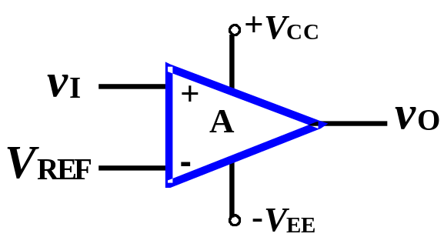


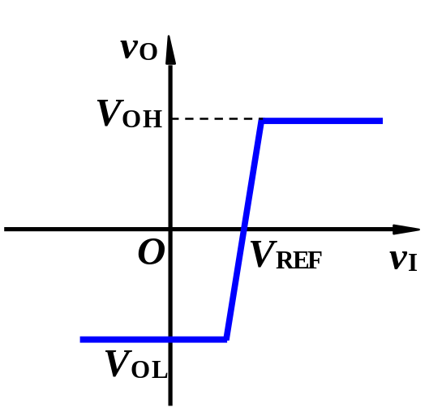
15.3.1. Comparator
Comparator compares two voltages one is input signal, other is reference voltage.
It is similar to op-amp.
Voltage transfer characteristic
It operates in an open-loop. No virtual short.
When v_{I} >V_{REF} , v_{O} =V_{OH}= +V_{CC} ;
v_{I} <V_{REF} , v_{O} =V_{OL}= -V_{EE} ;
Saturation voltage of output T is negligible.
It is a noninverting comparator.
Crossover voltage is defined as input voltage at which output changes states.

Slide 6
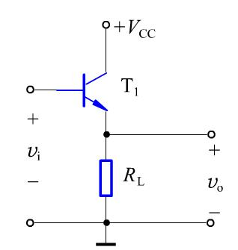
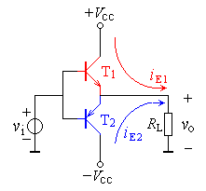
Out Stages

Slide 7
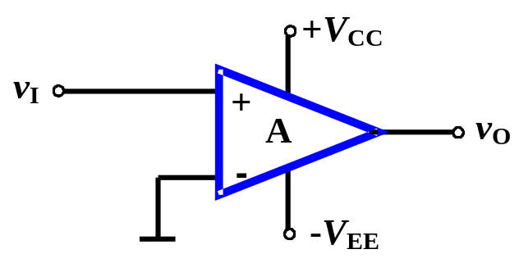
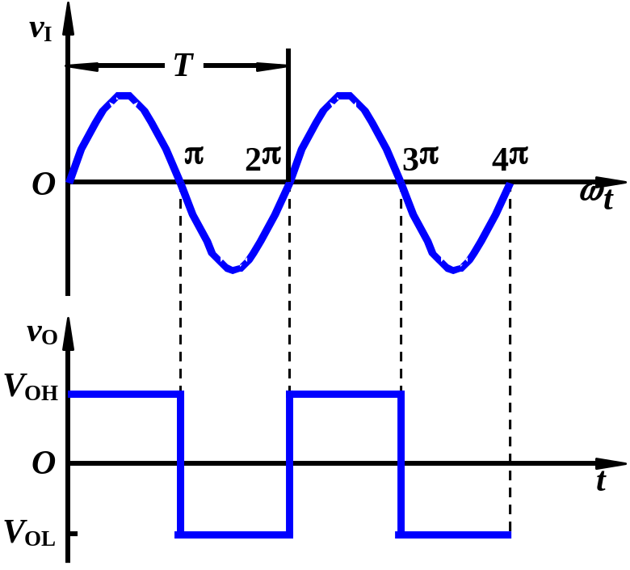
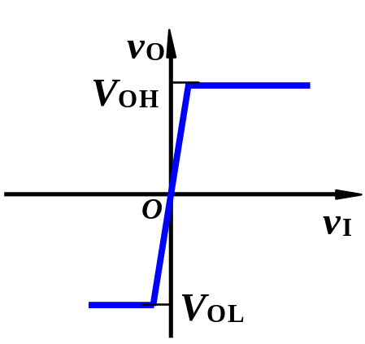

15.3.1. Comparator
When V_{REF} =0,__ Zero-Crossing Detector.
Voltage transfer characteristic
Input is sine-wave signal, output is square-wave signal.

Slide 8
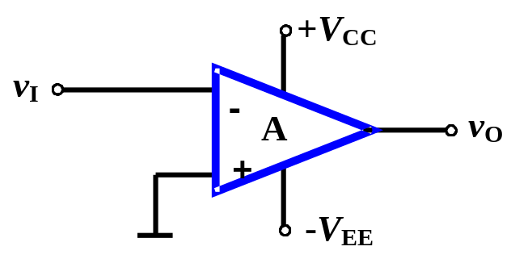
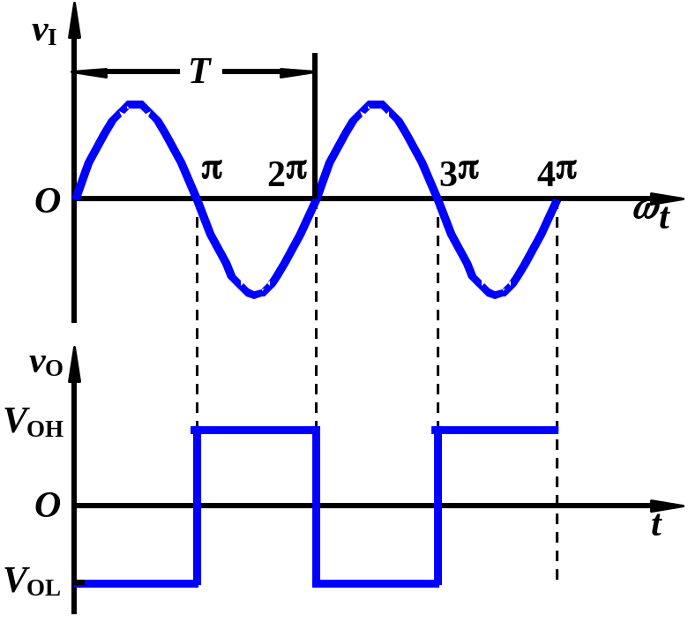
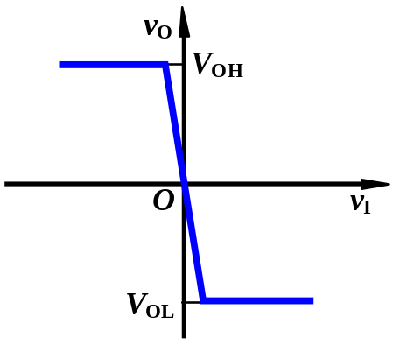
15.3.1. Comparator
Review Question
1. Zero-crossing detector shown in fig. Sketch the voltage transfer characteristics.
2. If Input is sine-wave signal, what is output waveform?

Slide 9
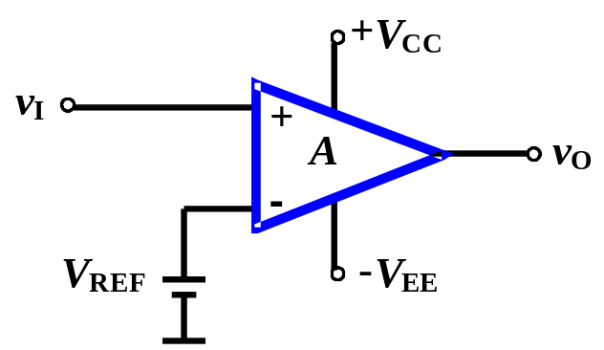
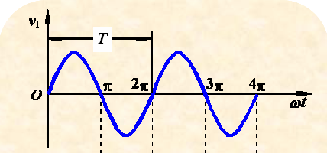
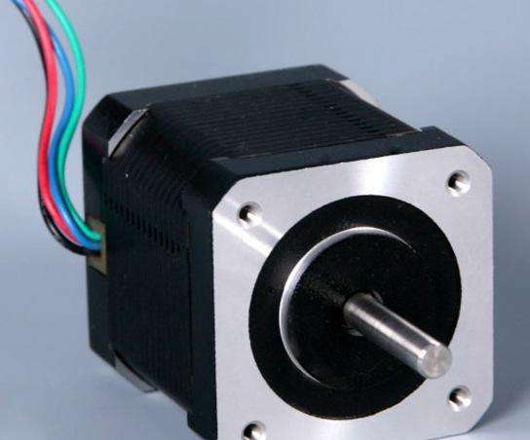
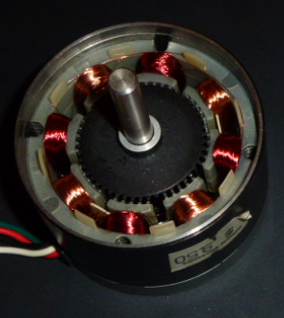
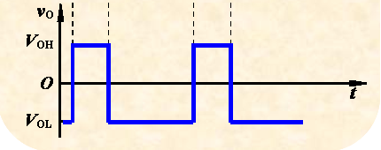
15.3.1. Comparator
Review Question
3. If V_{REF} is not zero, input is sine-wave signal,
sketch output waveform.
PWM，Pulse Width Modulation

Slide 10
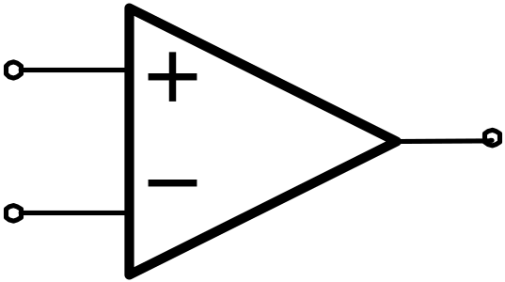
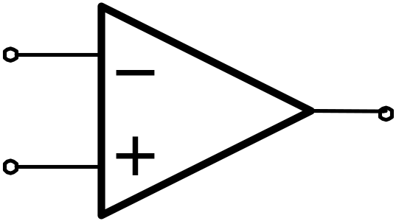
Zero-Crossing Detector:
u_{o}
v_{i}
+v_{OM}
u_{o}
u_{i}
0
-v_{OM}
v_{T}=0
u_{o}
v_{i}
u_{o}
+v_{OM}
u_{i}
0
v_{T}=0
-v_{OM}
Conclusion: if the input signal is in N terminal, from high level to low.
Conclusion: if the input signal is in P terminal, from low level to high.

Slide 11
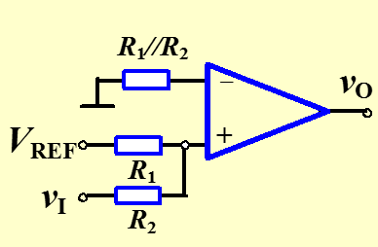
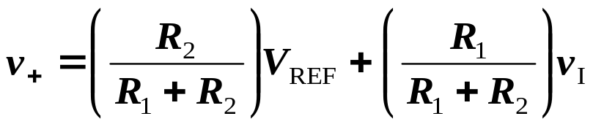

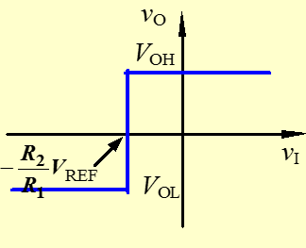
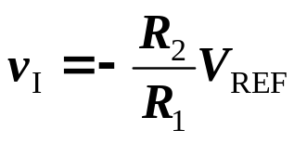
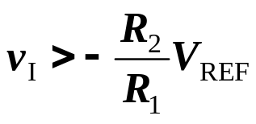
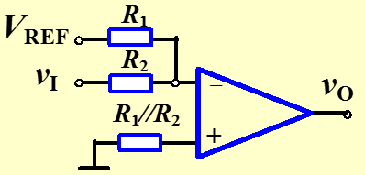
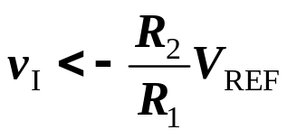
15.3.1. Comparator
Use superposition
Sketch the voltage transfer characteristics.
Crossover voltage
When v₊ =0 ,
v_{O} =V_{OH}= +V_{CC} ;
v_{O} =V_{OL}= -V_{EE} ;

Slide 12
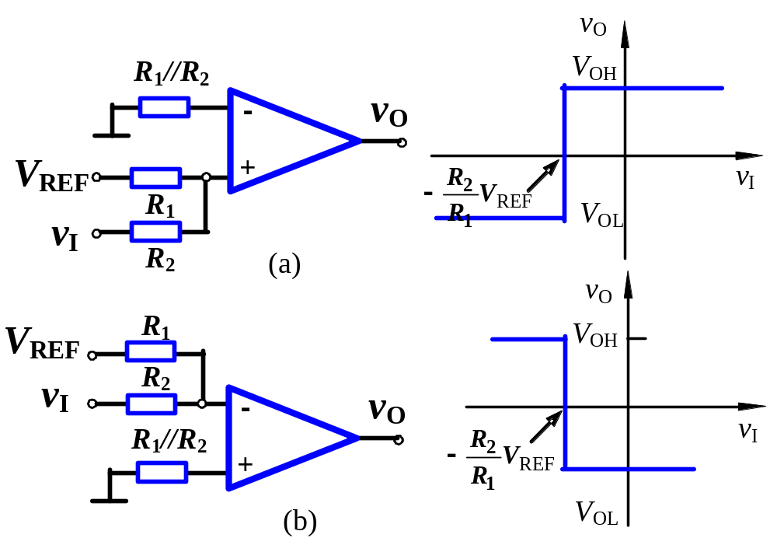
15.3.1. Comparator

Slide 13
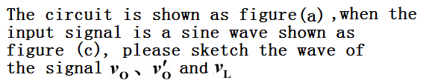
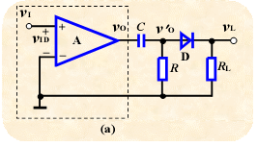

0
Zero-Crossing Detector
Differentiator
Rectifier

Slide 14
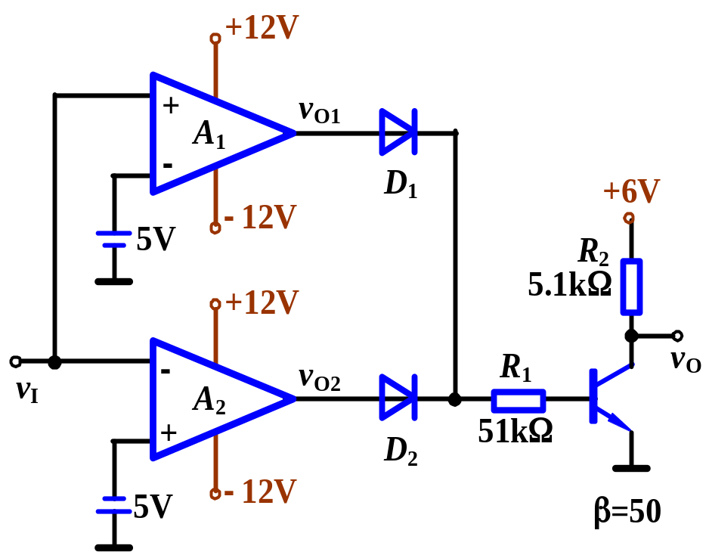

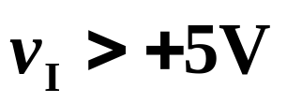
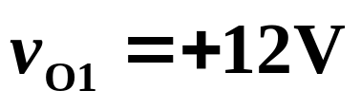
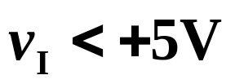
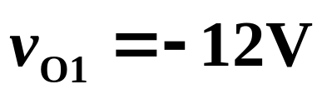
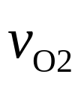
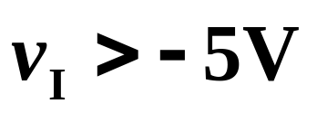
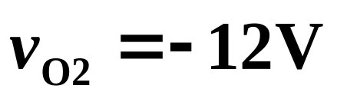
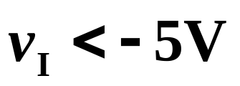

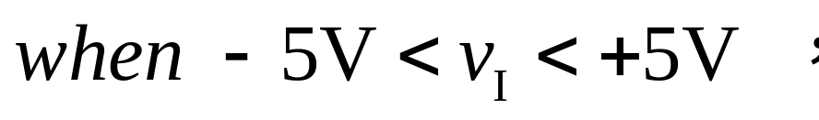
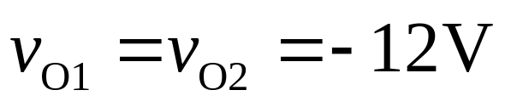

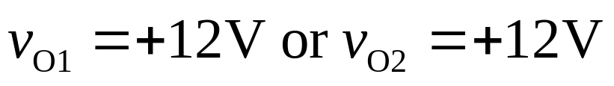
Sketch Voltage Transfer Characteristic
Sol：
(1) A₁ , A₂ open loop
→ Comparator

Slide 15
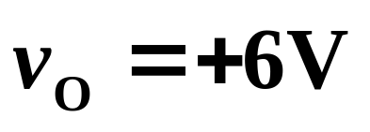
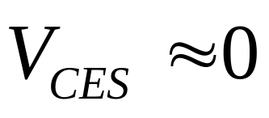
Sketch Voltage Transfer Characteristic
Sol：
then D₁ ,D₂ and BJT will cutoff.
then D1 or D2 will be on.
The BJT will work.
Active region or saturation region?
saturation region
→ v_{O} = 0V

Slide 16
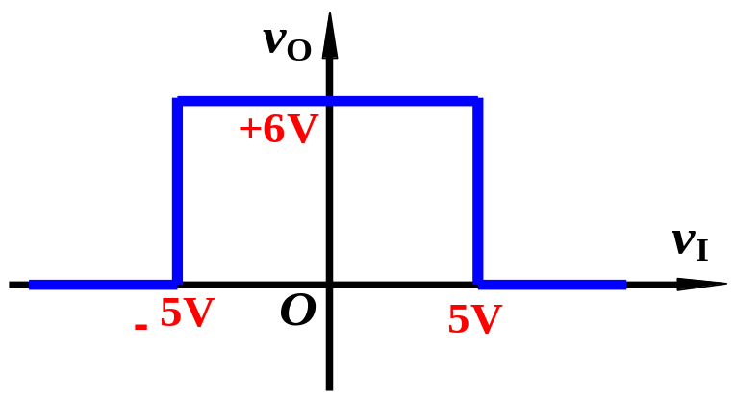
Sketch Voltage Transfer Characteristic
Sol：
v_{O} = 0V
What is the logic function of this part?
NOR Gate
windows comparator

Slide 17
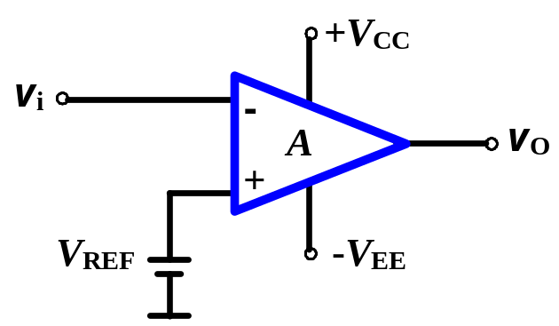
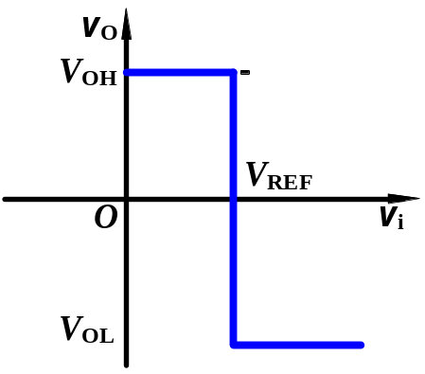




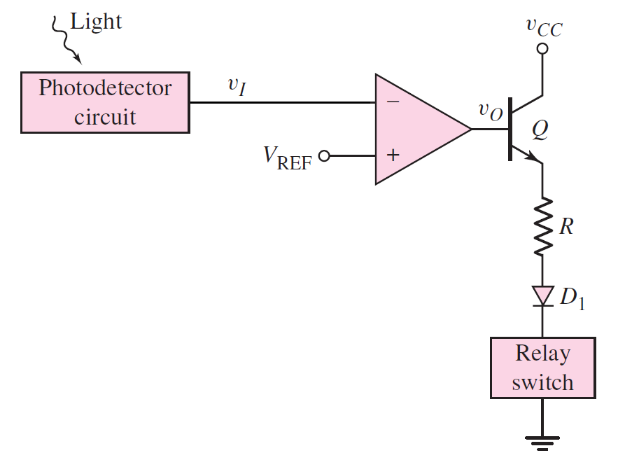




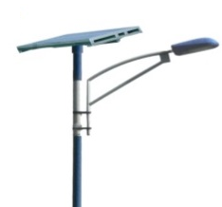

3. Comparator Application
v_{i}
v_{OL}
V_{REF}
OFF
t
v_{OH}
ON
output？
OFF
v_{O}
OFF
ON
v_{OH}
t
ON
OFF
ON
v_{OL}

Slide 18

3. Comparator Application
v_{i}
V_{REF}
t
v_{O}
v_{OH}
t
v_{OL}
v_{O}
v_{OH}
How to do？
t
v_{OL}

Slide 19
3. Comparator Application
v_{I}
V_{REF}
t
How to adjust the threshold ？
v_{O}
v_{OH}
t
v_{OL}

Slide 20
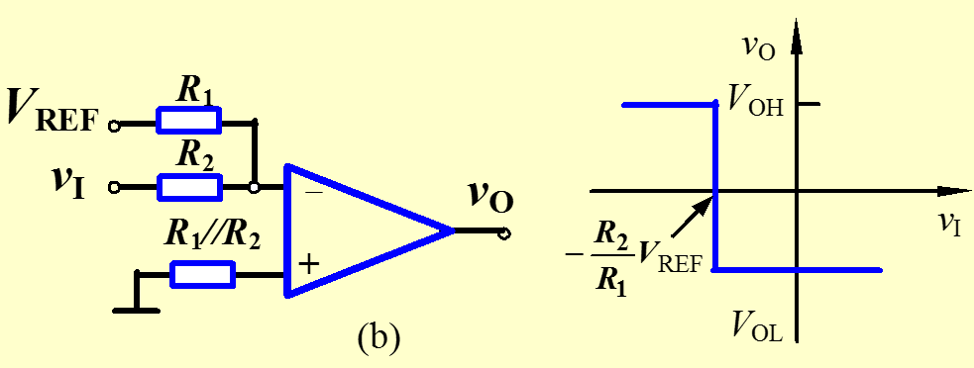
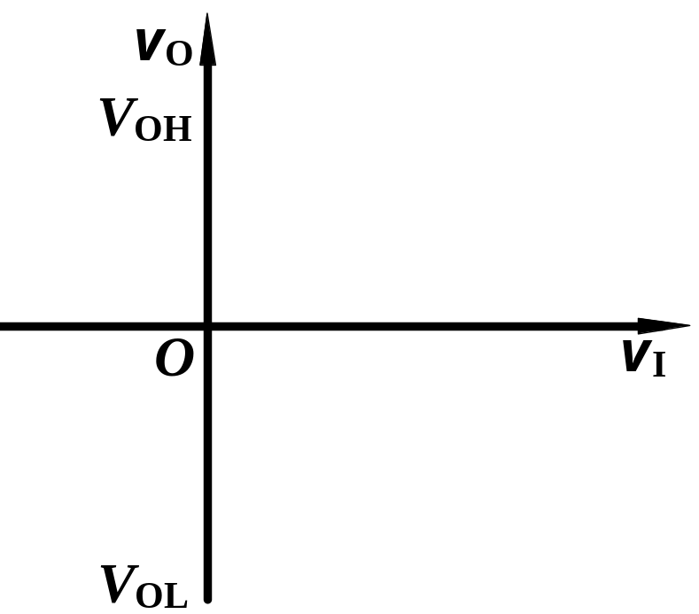
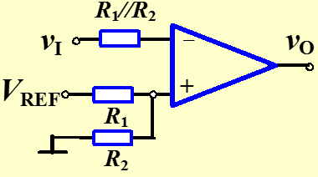

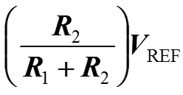

3. Comparator Application

Slide 21






15.3.2 Basic Inverting Schmitt Trigger
(1) Structure
(2) Crossover Voltages
It has two threshold (crossover) voltages.
Upper threshold voltage
Lower threshold voltage
Hysteresis width

Slide 22




15.3.2 Basic Inverting Schmitt Trigger
(3) Voltage Transfer Characteristic
V_{T-}
V_{T+}
if V_{O}=V_{OH}
if V_{O}=V_{OL}

Slide 23





15.3.2 Basic Inverting Schmitt Trigger
(3) Voltage Transfer Characteristic
v_{I}
V_{OH}
t
V_{REF}
V_{OL}
v_{O}
v_{OH}
t
Set V_{REF}=0
v_{OL}
V_{O}=？

Slide 24





15.3.3 Additional Schmitt Trigger Configurations
V_{S} is defined as switching voltage.
Two threshold voltages.
Hysteresis width
Voltage Transfer Characteristic

Slide 25
15.3.3 Additional Schmitt Trigger Configurations
1. Comparator
Conclusion:
For comparator, there are three key factors we must know:
⑴ crossover voltage V_{th}.
⑵ voltage jump direction.
Conclusion: if the input signal is in N terminal, from high level to low.
Conclusion: if the input signal is in P terminal, from low level to high.
⑶the output voltage.

Slide 26


15.3.3 Additional Schmitt Trigger Configurations
v_{i}
v_{o}
v_{i}
R
－
V_{+H}
+
t
+
V₊
V_{+L}
R₁
R₂
v_{o}
V_{om}
t
-V_{om}

Slide 27



15.3.3 Additional Schmitt Trigger Configurations

Slide 28



15.3.3 Additional Schmitt Trigger Configurations

Slide 29
Questions
and
Answers

